Slide 1

Image cryptography using Elliptic curve and Magic matrix with Advanced encryption standard
GROUP MEMBERS:
DERIL RAJU (BE/10489/16)
MUPPIDI SAI PRANAV (BE/10488/16)
LALITHA ELESWARAPU (BE/10435/16)
Guide
Dr. Rupesh Kumar Sinha

Slide 2
Contents
Motivation
Introduction
Objective
Literature Review
Methodology
Results and discussions
Future Works
References

Slide 3
Introduction
Image Cryptography is a widely used technique which has found great application in the fields of military and intelligence, social networking and financial services.
The main motto of cryptography is to service the growing need for increased security of information in various fields.
Objective
To design an efficient encryption/decryption scheme using Elliptic curve cryptography and Magic matrix scrambling technique with the help of AES encryption.

Slide 4
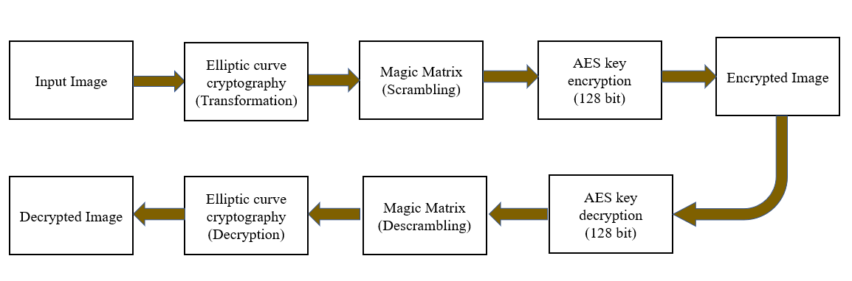
Proposed Block Diagram

Slide 5
Introduction to Elliptic curves
An elliptic curve is a plane curve defined by an equation of the form
y² mod p=(x³+ax+ b) mod p
‘a’ and ‘b’ are known as domain parameters; ‘a’ and ‘b’ decide the shape of the curve, while ‘p’ decides the range.
In our model, ECC has been used to transform pixel intensity values.
With respect to the curve, ‘x’ refers to the original pixel value while ‘y’ refers to the transformed value.

Slide 6
Encryption (ECC)
Decryption (ECC)
An elliptic curve Ep(a,b) was chosen.
An image is taken as input, and read as a matrix of pixel intensity values. These values range from 0(black) to 255(white).
An auxiliary base parameter(k), for example k = 20, was chosen.
An attempt was made to the solve the elliptic curve for x=mk+1 (for every m), where m represents an individual pixel intensity value.
If the curve could not be solved using x=mk+1, x=mk+2,3,4….(k-1) were given as inputs to the elliptic curve equation.
A value of y was reached before reaching x = mk + k-1. Thus a point (x,y) was now obtained on the elliptic curve, which represented a value in the input matrix.
The entire input image matrix was converted into a matrix of new points which represented solutions of the elliptical curve.
The elements in the encrypted image matrix and the quotient matrix were used to recover the mapped pixel intensity value.
The corresponding ‘x’ value was then found using the look-up table consisting of points on the elliptic curve, which was in turn used to solve for the original pixel intensity value.

Slide 7
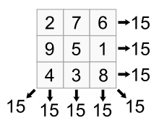
Magic Matrix
A magic square is “magic” because it contains the property that the square consists of the distinct positive integers 1, 2, …,N ² (N>=3) such that the sum of the N numbers in any horizontal, vertical or main diagonal line is always the same magic constant. For an NxN magic matrix, the sum of the rows or columns or diagonals can be given by N(N²+1)/2.
In the 3x3 matrix shown below, the values are arranged such that the sum of values in all the rows, columns and the diagonals is 15.

Slide 8
Encryption of Magic matrix
Before scrambling using the magic matrix, the two dimensional image matrix is traversed and each pixel value is transformed by looking up the S-box. The resultant two dimensional matrix is then converted into a one dimensional matrix. The one dimensional matrix is divided into chunks each with a size of 16 bytes.
Bit - XOR operation is performed between the 16 byte key and each chunk and the value of the pixel is replaced with the XORed value. While looping through chunks, the key is circularly rotated by 1 byte in every loop.
For scrambling using the magic matrix, the magic matrix is traversed, and each position is replaced by the pixel value that is contained in the index value that the position holds in the one dimensional matrix.
Hence the modified technique is a combination of both value transformation and position transformation.
The obtained 2 dimensional matrix is sent as an input to AES.

Slide 9
Decryption of Magic matrix
Create an empty one dimensional matrix which can accommodate all the pixel values and initialize the values with zeros.With the value at the magic matrix position as index for the one dimensional matrix, fill the position of the one dimensional matrix with the value at the same position of the encrypted pixel matrix while traversing magic matrix and input matrix.
Bitwise XOR operation is performed between the 16 byte key and each chunk of size 16 byte of the one dimensional matrix and the value of the pixel is replaced with this XORed value. While looping through the chunks, the key is circularly rotated by 1 byte in every loop. The rotation of the key should be similar to the rotation done in the encryption end.
This one dimensional matrix after performing the XOR operation is then reshaped into a two dimensional matrix of the dimension NxN. The reshaped matrix is traversed and each value is mapped back using the inverse S-box and the value is replaced by the mapped value.
This resultant decrypted matrix is sent as an input to the ECC decryption block.

Slide 10
Advanced Encryption Standard (AES)
It uses higher length key sizes such as 128, 192 and 256 bits for encryption. Hence it makes AES algorithm more robust against hacking.
For 128 bit, about 2^128 attempts are needed to break. This makes it very difficult to hack it as a result it is very safe protocol.
AES repeats 4 major functions to encrypt data. It takes 128-bit block of data and a key and gives a ciphertext as output. The functions are:
Sub Bytes, Shift Rows, Mix Columns, Add Round Key
The number of rounds performed by the algorithm strictly depends on the size of key.
Table 1. AES parameters
Algorithm | Key length Nk | Block size Nb | No. of Rounds Nr
AES-128 | 4 | 4 | 10
AES-192 | 6 | 4 | 12
AES-256 | 8 | 4 | 14

Slide 11
Steps in AES Encryption
AES Decryption
The following steps are followed in each round of AES Encryption
Sub Bytes: Each element of the matrix is replaced by the an element of s-box matrix.
Shift Rows: In this step rows of the block are cylindrically shifted in left direction. The first row is untouched , the second by one shift, third by two and fourth by 3.
Mix Columns: In this step the column is multiplied with a fixed matrix, and multiplication is in galios field.
Add Round Key: In final step the block is XORed with the key.
The AES decryption basically traverses the encryption algorithm in the opposite direction. AES decrypto initially performs key expansion on the key block that created all intermediate keys.

Slide 12
Results and Discussions
Parameters in consideration:
Number of changing pixel rate (NPCR) and Unified Averaged Changed Intensity(UACI): The NPCR measures the percentage of different pixels that change in two images which is the encrypted image when only one pixel is changed in the original image, while UACI measures the average intensity of differences between the original and encrypted images.
Entropy: Information entropy is a concept that tells how much information there is in an image. In general, the more uncertain or random the image is, the more information it will contain. It evaluate the scattering of pixel values in the image. For grayscale images entropy is theoretically equal to 8.
Correlation Coefficient: Correlation test consists of randomly selecting N pairs of adjacent pixels (vertical, horizontal, and diagonal) from the original and the encrypted images separately. Then, the correlation coefficient of each pair is calculated using
Key Sensitivity: Encryption algorithms should also have high sensibility to encryption key. This means that any small change in the key should lead to a significant change in the encrypted, or decrypted, image.

Slide 13
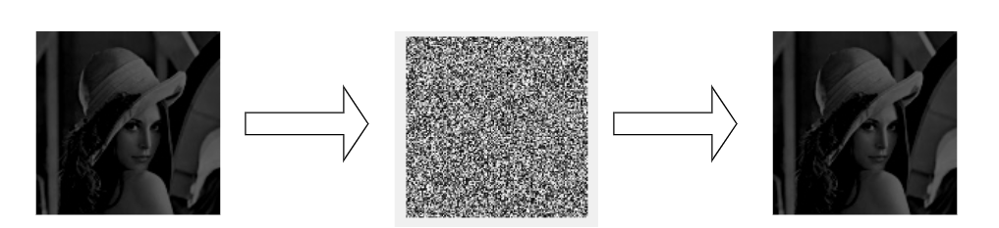
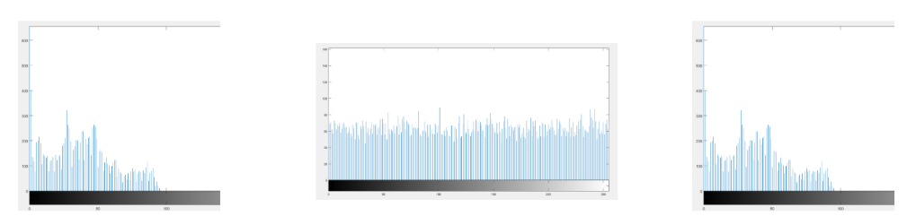
Results (Lena Image)
Input: Lena Image Encrypted Image Decrypted Image
Hist: Lena Image Hist: Encrypted Image Hist: Decrypted Image
Fig 25: Lena image encryption and decryption

Slide 14
Parameter comparison (Lena)
Methods | Parameters
 | Correlation Coefficient |  | Entropy | Sensitivity Analysis
 | With Encrypted Image | With Decrypted Image |  | NPCR | UACI
Proposed Method (lena image) | -0.000658 | 0.9887 | 7.998 | 0.9959 | 0.3068
Enhanced 3D logistic map^{[3]} | −0.0237 | 0.9658 | 7.991 | 0.9940 | 0.335
Double spiral scan and chaotic map^{[2]} | 0.0032 | 0.9757 | 7.997 | 0.9972 | 0.335

Slide 15
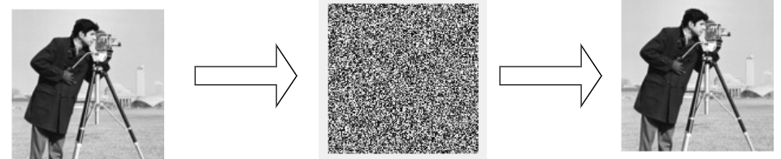
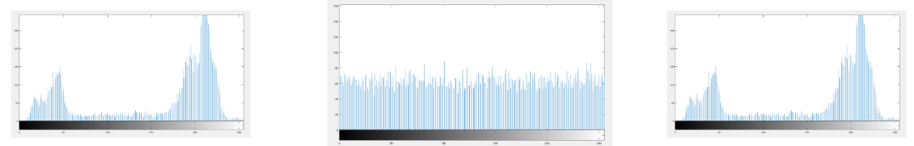
Results (Cameraman Image)
Input: Cameraman Image Encrypted Image Decrypted Image
Hist: Cameraman Image Hist: Encrypted Image Hist: Decrypted Image
Fig 26 Cameraman image encryption and decryption

Slide 16
Parameter comparison (CameraMan)
Methods | Parameters
 | Correlation Coefficient |  | Entropy | Sensitivity Analysis
 | With Encrypted Image | With Decrypted Image |  | NPCR | UACI
Proposed Method (cam man image) | 0.00261 | 0.9887 | 7.991 | 0.9956 | 0.3268
Enhanced 3D logistic map^{[3]} | −0.0537 | 0.9858 | 7.989 | 0.9840 | 0.331
Double spiral scan and chaotic map^{[2]} | -0.0009 | 0.9796 | 7.997 | 0.9962 | 0.334

Slide 17
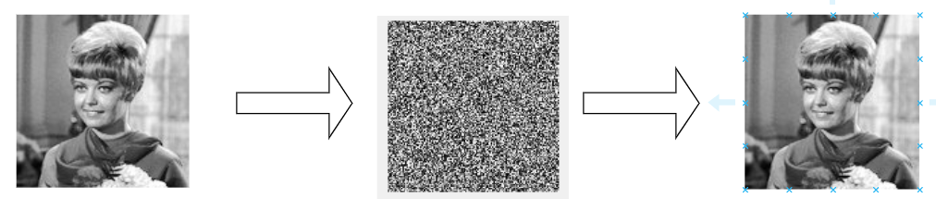
Results (Girl Image) [Test Image I]
Input: Girl Image Encrypted Image Decrypted Image
Fig 28: Girl image encryption and decryption
Methods | Parameters
 | Correlation Coefficient |  | Entropy | Sensitivity Analysis
 | With Encrypted Image | With Decrypted Image |  | NPCR | UACI
Proposed Method (girl image) | 0.0013 | 0.9887 | 7.988 | 0.9962 | 0.3056

Slide 18
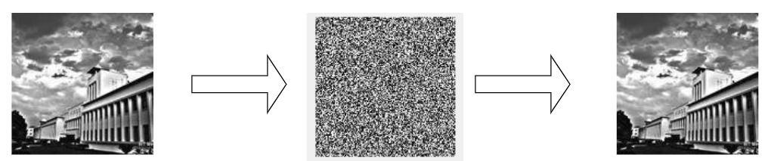
Results (BIT Mesra Image) [Test Image II]
Input: BIT Image Encrypted Image Decrypted Image
Fig 29: BIT image encryption and decryption
Methods | Parameters
 | Correlation Coefficient |  | Entropy | Sensitivity Analysis
 | With Encrypted Image | With Decrypted Image |  | NPCR | UACI
Proposed Method (BIT image) | -0.0068 | 0.9887 | 7.990 | 0.9957 | 0.3219

Slide 19
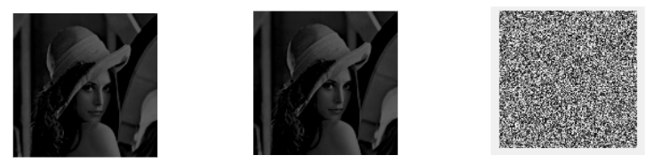
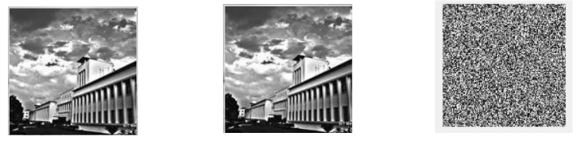
Key sensitivity
The below results shown are for decrypted outputs when the key is changed slightly (One nibble in this case)
Correct Key: 00 01 02 03 04 05 06 07 08 09 0A 0B 0C 0D 0E 0F
Wrong Key: 00 01 02 04 04 05 06 07 08 09 0A 0B 0C 0D 0E 0F
Original Image Decrypted (Correct key) Decrypted (Wrong key)
Fig 30: Key Sensitivity for lena and BIT image

Slide 20
Comparison of proposed model with other similar model
The following is a parameter comparison for our proposed block and another model which uses ECC and AES for image cryptography⁽⁴⁾.
Methods | Parameters (LENA IMAGE)
 | Correlation Coefficient |  | Entropy | Sensitivity Analysis
 | With Encrypted Image | With Decrypted Image |  | NPCR | UACI
Proposed Method (ECC + MM+ AES) | -0.000658 | 0.9887 | 7.998 | 0.9959 | 0.3068
Other Method (ECC + AES) | -0.0017 | 0.9798 | 7.993 | 0.9956 | 0.3233

Slide 21
Comparison of Magic Matrix (MM) and Advanced Encryption Standard (AES)
The below is a comparison for the blocks Magic matrix and Advanced Encryption Standard (AES). This analysis is done to compare the Proposed block and the actual encryption standard used worldwide.
The test is done on two standard and two test images, so that we can have a clear idea about the performance on both standard and real life images.

Slide 22
Comparison on Standard Images
Blocks | Parameters (LENA IMAGE)
 | Correlation Coefficient |  | Entropy | Sensitivity Analysis
 | With Encrypted Image | With Decrypted Image |  | NPCR | UACI
Magic Matrix | 0.0151 | 0.9987 | 7.966 | 0.9958 | 0.2840
AES | 0.0069 | 0.9998 | 7.9885 | 0.9957 | 0.2826
Blocks | Parameters (CAMERAMAN IMAGE)
 | Correlation Coefficient |  | Entropy | Sensitivity Analysis
 | With Encrypted Image | With Decrypted Image |  | NPCR | UACI
Magic Matrix | -0.0182 | 0.9987 | 7.9039 | 0.9974 | 0.331
AES | -0.0168 | 0.9998 | 7.9814 | 0.9956 | 0.332

Slide 23
Comparison on Test Images
Blocks | Parameters (GIRL IMAGE)
 | Correlation Coefficient |  | Entropy | Sensitivity Analysis
 | With Encrypted Image | With Decrypted Image |  | NPCR | UACI
Magic Matrix | 0.0025 | 0.9977 | 7.9805 | 0.9957 | 0.304
AES | -0.0019 | 0.9998 | 7.9888 | 0.9976 | 0.305
Blocks | Parameters (BIT MESRA IMAGE)
 | Correlation Coefficient |  | Entropy | Sensitivity Analysis
 | With Encrypted Image | With Decrypted Image |  | NPCR | UACI
Magic Matrix | -0.00021 | 0.9997 | 7.9793 | 0.9964 | 0.320
AES | 0.00979 | 0.9998 | 7.9870 | 0.9963 | 0.321

Slide 24
Conclusion
In this project, we have proposed a model for image encryption that offers greater security and efficient scrambling of image pixels. We have used a combination of elliptic curve cryptography, magic matrix scrambling and advanced encryption standard (AES) in this technique, and security analysis shows that the proposed encryption scheme has almost ideal entropy and correlation coefficients, i.e. there is minimum correlation between the original and encrypted image and an almost exact recovery of the original image after decryption.
Upon analysis using parameters such as NPCR and UACI, it produces better results when compared to other encryption models. We also have compared our proposed block with the widely used encryption scheme, AES.

Slide 25
Future Work
To expand the scope of the proposed idea to RGB images (True coloured images).
Implement Steganography for a robust and secure key transmission.
To explore the properties of magic matrix and increase the strength of the proposed method by using a unique way of filling the magic matrix for a given order out of many possible matrices.

Slide 26
References
[1] Padma Bh, D.Chandravathi, P.Prapoorna Roja, “Encoding And Decoding of a Message in the implementation of Elliptic Curve Cryptography using Koblitz’s Method” International Journal on Computer Science and Engineering, Vol. 02, No. 05, 2010, 1904-1907.
[2] Congxu Zhu ,2 and Zhijian Wang, “An Improved Piecewise Linear Chaotic Map Based Image Encryption Algorithm”, Volume 2014 |Article ID 275818
[3] Kaixin Jiao, Chen Pan, and Xiaoling Huang, “An Effective Framework for Chaotic Image Encryption Based on 3D Logistic Map”, Volume 2018 |Article ID 8402578
[4] Toughi Shahriyar, Mohammad H. Fathi, Yoones A. Sekhavat, An ImageEncryption Scheme Based on Elliptic Curve Pseudo Random and Advanced Encryption System, SignalProcessing (2017), doi: 10.1016/j.sigpro.2017.06.010
[5] Laiphrakpam Dolendro Singh, Khumanthem Manglem Singh, “Image Encryption using Elliptic Curve Cryptography”, Eleventh International Multi-Conference on Information Processing-2015 (IMCIP-2015), doi: 10.1016/j.procs.2015.06.054
[6] MATLAB 2015a and 2017a Summary and documentation.
[7] S. Sowmiya, I. Monica Tresa, A. Prabhu Chakkaravarthy, “Pixel based image encryption using magic square”, 2017 International Conference on Algorithms, Methodology, Models and Applications in Emerging Technologies (ICAMMAET), 10.1109/ICAMMAET.2017.8186634.
[8] D.I. George Amalarethinam, J. Sai geetha, "Enhancing Security Level for Public Key Cryptosystem Using MRGA", World Congress on Computing and Communication Technologies (WCCCT), pp. 98-102, 2014, ISBN 978-1-4799-2876-7.

